Slide 1
Day 3 - Session 3: Version control with GitHub
David Souto
School of Psychology and Vision Sciences

Slide 2
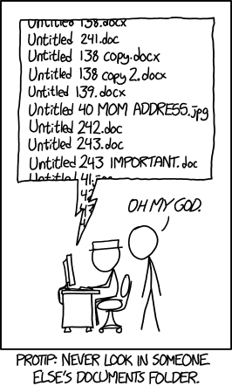
Version control
Keep track of changes in a project
Ability to go back to earlier versions
Similar to track-changes in word for code
Facilitate exchange & ultimately sharing code
https://xkcd.com/1459/
Notes:
It is bad enough with word documents. Code tends to be organized in messier ways. We need to work with each other and find better ways to share documents.
For something more textual, there is a very nice guide to version control and GitHub here:
Version control: https://book.the-turing-way.org/reproducible-research/vcs/
Github novice: https://book.the-turing-way.org/collaboration/github-novice

Slide 3
Git and GitHub
Git
[Definition]
GitHub
[Definition]
We’ll focus on tools that have made GitHub the go-to option to store code for the research community
Will try convincing you that it is plenty useful with just one user of a repository
Notes:
GitHub is an incredibly popular website to share code. It uses Git for version control, a command line tool. You can use Git through the command line and through a very handy app called GitHub Desktop.
A common assumption is that version control is only efficient / useful with larger projects. We will show this is not the case. Another misconception is that it is too much faff / complication for a simple project. This will also appear misguided today. We’ll start with level 1, which his sufficient to provide you with: the ability to share code, back up code, seamlessly synchronize code between computers, have a record of changes and return to working versions of the code.
The goal of the session is to show you how to use GitHub to share your code (ordocumentation) and use it as a way to collaborate with people efficiently. We shallsee that we can grasp the basic functionality in short time. Going through all theintricacies would take a lot longer, but one of the reasons GitHub is so popular isthat it simplified version-control via git for most common tasks. For instance, wecan synchronize files via a visual interface (GitHub Desktop) instead of using the command line.For small projects, where you often have 1-2 people working on code, this crashcourse should be enough to get you started. Even if you don’t intend to publishyour code GitHub is a good way of keeping track of versions and sharing it withfuture collaborators as you will be ale to revert to previous versions & resolveconflicts more easily than if everyone had independent copies, with file dates and names (“analysis_last_final_v5.R”) as the only way to keep track of the lastversion. Other advantages of using GitHub: - Facilitates collaboration with others. - Allowsyou to back up your code online (not the data)- Allows to showcase your work and keep track of how people interact with it;providing proof of impact.
For small projects, where you often have 1-2 people working on code, this crashcourse should be enough to get you started. Even if you don’t intend to publishyour code GitHub is a good way of keeping track of versions and sharing it withfuture collaborators as you will be ale to revert to previous versions & resolveconflicts more easily than if everyone had independent copies, with file dates andnames (“analysis_last_final_v5.R”) as the only way to keep track of the lastversion.Other advantages of using GitHub: - Facilitates collaboration with others. - Allowsyou to back up your code online (not the data)- Allows to showcase your work and keep track of how people interact with it;providing proof of impact.

Slide 4
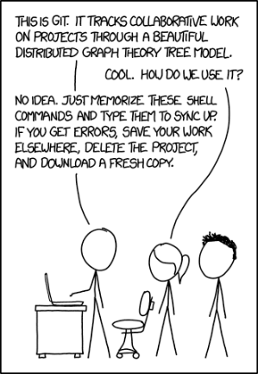
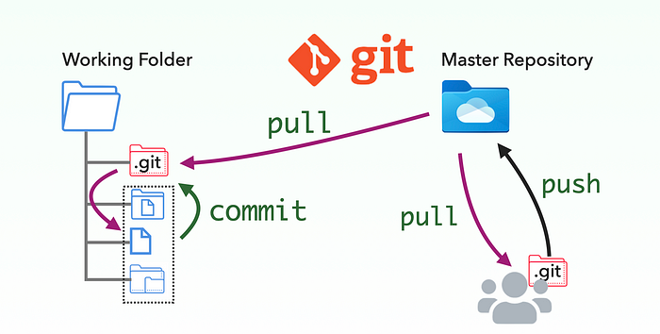
Terminology
https://zhiminzhan.medium.com/10-minutes-guide-to-git-version-control-for-testers-f58e059bb5e7
Xkcd Randall Monroe
Notes:
If you want to have a deeper understanding of it; say you work with in a large group of people that will be quite familiar with the do’s and don’s and are likely to use git commands, you will find several tutorials, e.g. https://git-scm.com/docs/gittutorial

Slide 5
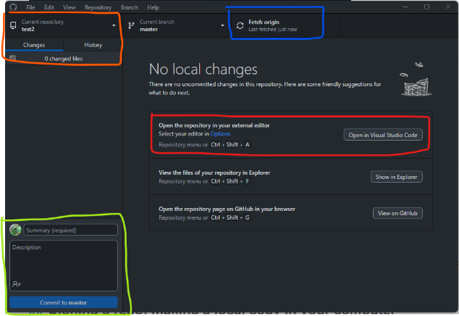
Tour of GitHub Desktop: Demo
Notes:
Red
Blue
Orange
Green
If you really want to use the command line, you can find a nice, short introduction here: https://book.the-turing-way.org/reproducible-research/vcs
We are not going to talk about version control for data. Goes beyond what we can cover. Relevant for the machine learning community. More here https://book.the-turing-way.org/reproducible-research/vcs/vcs-data

Slide 6

Integration with OSF
Connect to GitHub on the OSF

Slide 7
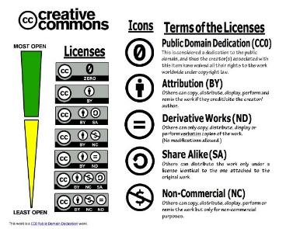



Licensing that encourages reuse
Text / articles: The Creative Commons 4.0 license
Code: BSD-2-Clause license, MIT License, GNU GPL.
This work is a CC0 Public Domain Dedication.
Notes:
The Creative Commons 4.0 license: common with educational resources or articles. It is a very non-restrictive license; you simply need to attribute authorship and re-share with the same license.
Not always appropriate for code. BSD-2-Clause license, common for code.
Use this infographic to understand the various CC licenses and their terms. ​​​​​This work is a CC0 Public Domain Dedication.

Slide 8
Worksheets
Ex
Ex
Ex
Ex

